Slide 1
Chapter 8
Water Conservation

Slide 2
Ch. 8 Terms to Know
nonpoint source – source of water pollutants that does not come from a single, easily identified point
point source – source of water pollutants easily traced to a single point, such as a factory pipe or animal feedlot
runoff – water that falls on the soil but fails to be absorbed; flows on the soil surface.
water table – upper surface of a layer of saturated material in the soil.

Slide 3
Chapter 16
Tillage and Cropping Systems

Slide 4
Tillage
Works soil and prepares it for seed placement, germination, and crop growth
Affects many other factors involved in farming
3 basic goals
Weed control
Alteration of physical soil conditions
Management of crop residues

Slide 5
Uses of Tillage
Weed control (only tool before herbicides)
Before planting: prepares a weed-free seedbed
After planting: destroys and buries weed seedlings

Slide 6
Uses of Tillage (cont’d.)
Physical soil conditions
Benefits of tillage
Alters soil structure, moisture, and temperature
Stirs and loosens soil
Improves aeration
Creates suitable medium for growth
Can break up subsoil compaction (“plowpan”)

Slide 7
Uses of Tillage (cont’d.)
Physical soil conditions
Problems of tillage
Loss of organic matter
Crushed aggregates
Soil compaction and tillage pans from wheel traffic
Long-term decline in physical structure
Crusting

Slide 8
Uses of Tillage (cont’d.)
Crop residue management
Amount of residue depends on the type of crop, how well it grew, and how it is harvested
Methods: moldboard plowing, tillage tools, etc.
Seedbed preparation – critical timing
Moisture
Temperature
Air for respiration

Slide 9
Conventional Tillage
Stages
Primary tillage: breaks up soil
Moldboard plow
Chisel plow
Secondary tillage: often a two-step harrowing process
Disk harrow

Slide 10
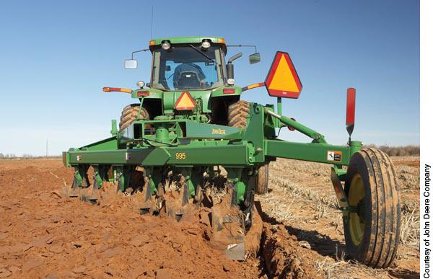
Figure 16-3, p. 370

Slide 11
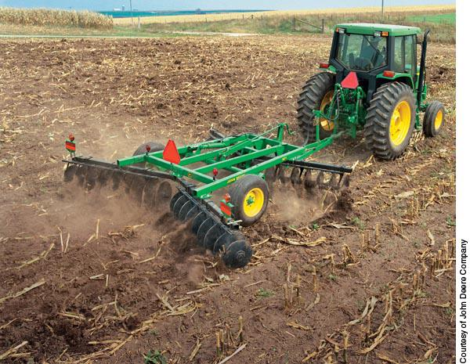
Figure 16-5, p. 372

Slide 12
Conventional Tillage (cont’d.)
Timing and depth of plowing
Eastern United States: fall or spring
Western United States: immediately after harvest
Contrast with “reduced” or “minimum” tillage

Slide 13
Conservation Tillage
Program of crop residue management
≥30% of soil surface covered with crop residues
Reduces erosion
Benefits
Reduces water and wind erosion by 50% to 60%
Increases soil moisture and improves filtration
Reduces evaporation and runoff
Improves organic matter content near the soil surface
Less time in field work and lower fuel costs
Increases biological diversity and carbon sequestration

Slide 14
Conservation Tillage (cont’d.)
Challenges
Greater reliance on herbicides for weed control
Fertilization practices must be adapted
Methods
Mulch till or chisel-plow
No-till (~90% of soil surface is untouched)

Slide 15
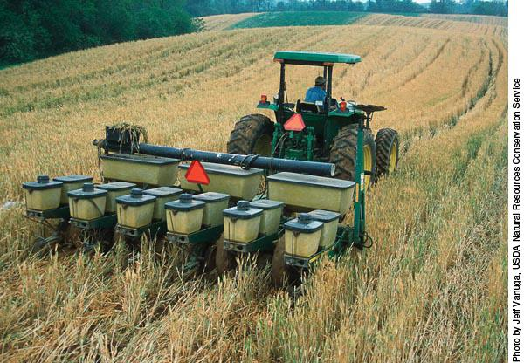
Figure 16-8, p. 376

Slide 16
Differences between Conventional and Conservation Tillage
Equipment
Design must accommodate heavy residues
Matching tillage to soil type
Soils tend to be cooler and wetter with conservation tillage
“Local extension agents provide advice on the best system” (Still true?)

Slide 17
Cropping Systems
Continuous cropping
Same crop grown each year
Crop rotation
Series of different crops is planted on the same piece of land in a repeating system (e.g., row crop, small grain, forage)
Benefits
Insect, disease, and weed control
Legumes can supply nitrogen
Improves organic matter/tilth
Reduces erosion

Slide 18
Cropping Systems (cont’d.)
Types of crops used for rotations
Row crops: wide rows, most profitable
Small grains: oats or wheat
Perennial forages: green matter for animal consumption
Double cropping: harvesting two crops from the same piece of land in one year
Cover cropping: planting two crops in one year, but one is not harvested and is a conservation tool
Intercropping: growing more than one crop at one time

Slide 19
Sustainable Agriculture
Long-term sustainable agriculture practice
Enhances environmental quality and the agricultural resource base
Provides for basic human food and fiber needs
Economically viable
Enhances the quality of life for farmers and society

Slide 20
Sustainable Agriculture (cont’d.)
Soil and water management
Crucial for sustainability
Techniques include:
Crop rotation
Conservation tillage
Cover cropping
Nutrient management

Slide 21
Sustainable Agriculture (cont’d.)
Organic farming
Prohibits the use of synthetic substances
Stresses managing soil organic matter and soil organisms
Keeps soil quality high so fewer outside inputs are required

Slide 22
Summary
This chapter reviewed several topics
Goals of tillage
Weed control
Alteration of physical soil conditions
Crop residue management
Side effects of tillage
Erosion
Compaction
Reduced permeability

Slide 23
Summary (cont’d.)
Conventional tillage
Buries crop residues
Conservation tillage
Leaves crop residues on surface
Offers greater potential for carbon storage
Cropping systems
Continuous
Crop rotation
Multiple cropping
Organic farming
Sustainable agriculture that bans the use of synthetic products

Slide 24
Chapter 18
Soil Conservation

Slide 25
Objectives
After completing this chapter, you should be able to:
List the effects of soil erosion
Describe how soil erosion occurs
List the types of water and wind erosion
Calculate soil loss from water erosion on a field
Describe ways to prevent erosion
Discuss climate change and erosion

Slide 26
Erosion
Natural erosion
Has always shaped the earth’s surface
Human-induced erosion
Created by agriculture
Far exceeds geologic rates
Erosion-control practices
Help reduce rates
Example: conservation tillage

Slide 27
Figure 18-1, p. 408
Average losses on non-federal land in U.S.
“Acre-furrow slice” = 1,000 tons/acre

Slide 28
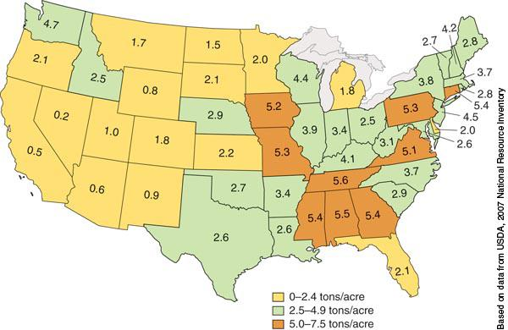
Figure 18-2, p. 408
Estimated ave. Tons/Acre/Year by state (Pattern?)

Slide 29
Consequences of Erosion
On-site damage
Topsoil removal
Plant nutrient removal
Organic matter removal
Decreased root zones
Thinned soil profile
Decline in soil structure stability
Gullies negatively reshape land

Slide 30
Consequences of Erosion (cont’d.)
Off-site problems
Nutrient and pesticide pollution to nearby waters
Soil particles reduce water clarity
Sediments deposit in waters
Dredging behind Conowingo Dam

Slide 31
Costs of Erosion
Include:
Production losses
Farmer and consumer
Pollution and sedimentation
Public (shared costs)

Slide 32
Water Erosion
Erodes more soil than the wind
Even in dry climates
The process of water erosion
Raindrops shatter surface aggregates and loosen soil particles
Soil particles are carried downslope by flowing water
When moving water slows, soil is deposited

Slide 33
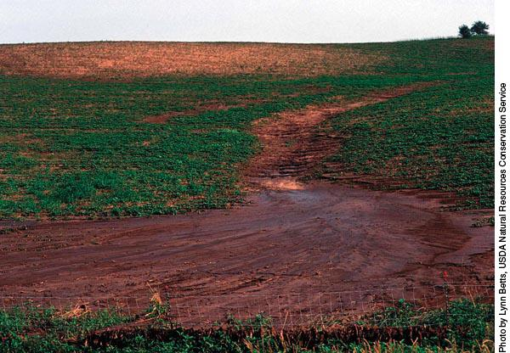
Figure 18-6, p. 412
Effects of sheet erosion visible in background

Slide 34
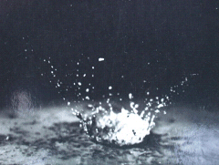
Influence of raindrops
Raindrop impact exerts three important effects:
Detaches soil
Destroys granulation (soil structure)
Splash can cause transportation of soil

Slide 35
Types of Erosion
Splash erosion - movement of soil by splashing (≤5 feet)
Sheet erosion - removal of a thin sheet of soil
Rill erosion - creation of small channels on a slope (can be smoothed with tillage)
Ephemeral gullies - large rills
Gully erosion - wide, deep channels too large to cross with equipment
Notes:
Sheet – splashed soil is removed more or less uniformly. Sheet flow concentrated into tiny channels are termed rills
Rill erosion then become dominant – common on bare land. Small enough to be smoothed by normal tillage, but damage already done – soil is lost.
Gullies – deeper rills – obstacles to farm equipment; cannot be removed by normal tillage

Slide 36
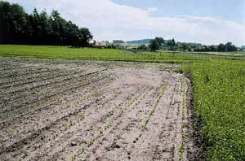
Sheet erosion 1 mm. thickness = about 6 Tons/Acre (based on bulk density calculation)
Notes:
Hidden soil loss – no visible signs until subsoil appears

Slide 37
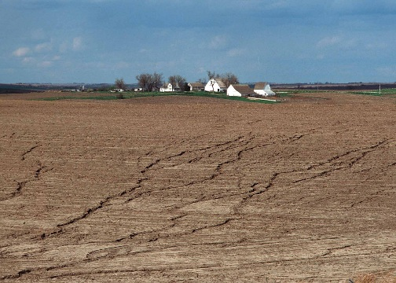
Rill erosion
Notes:
Rill erosion can be hidden b/c each tillage causes the rills to disappear. The amount of the hidden erosion can be easily underestimated by a grower. Transition between rill and gully is ephemeral rill. Can move equipment over it, but it doesn’t completely fill in the ephemeral channel. It can be the seed for gully formation.
Some soil conservation measures must treat these two forms of erosion differently. The USLE, the main tool for estimating erosion rates, predicates only sheet and rill erosion, not ephemeral erosion. Thus the equation can seriously underestimate soil loss on fields with a great deal of ephemeral erosion.

Slide 38
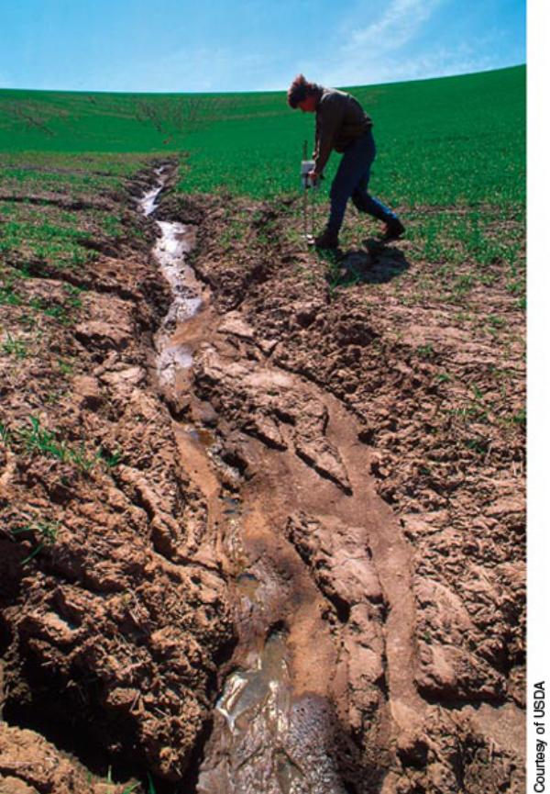
Figure 18-10, p. 416
Rills
Ephemeral
Gully

Slide 39
Water Erosion (cont’d.)
Rainfall erosivity
Volume: total rainfall in a rainfall event
Intensity: how fast rain falls
Texture and structure
Affects infiltration rate
Particle size affects detachment
Slope
Length
Grade

Slide 40
Water Erosion (cont’d.)
Soil cover
Mulch and cover crops reduce erosion
Row crops and nursery stock intercept rainfall and can reduce erosion
“canopy effect”
Surface roughness
Rough soil impedes downhill water flow
However, erosion can be worse if water collects behind ridges and they break

Slide 41
Predicting Soil Loss
Universal Soil Loss Equation
A = R K LS C P
A: Tons of soil lost per acre each year (Target rate)
R: Rainfall and runoff factor (changing?)
K: Soil erodibility factor
LS: Slope factor
C: Cover and management factor
P: Support practice factor
Revised: refined factor values (“RUSLE”)

Slide 42
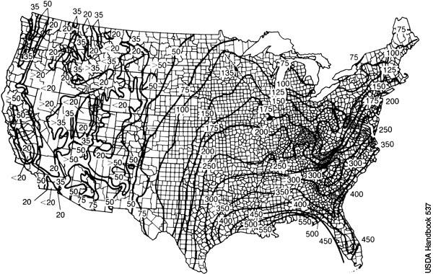
Figure 18-13, p. 419
For Harford County, between 175 and 200

Slide 43
Soil Erodibility Factor, K

Slide 44
Soil Properties Used for K
Silt and sand content (texture)
Organic matter content
Soil structure (type & size)
Very fine granular best
Blocky, platy or massive worst
Coarser granular intermediate
Permeability
K_{w} (whole soil) in Harford County: .15 to .49

Slide 45
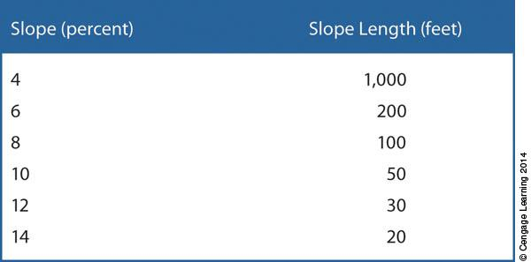
Figure 18-7, p. 414
2 factors result in same amount of erosion

Slide 46
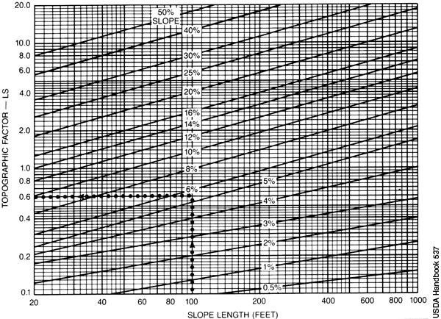
Figure 18-14, p. 420

Slide 47
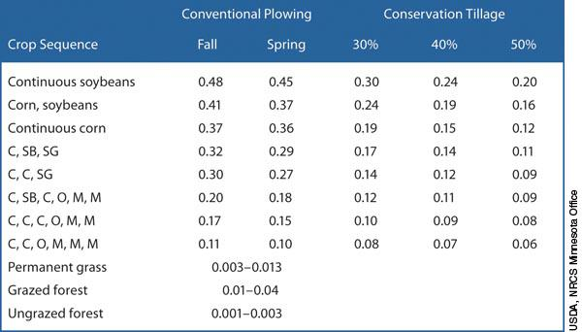
Figure 18-15, p. 420
C factor, compared with bare soil (1.0)

Slide 48
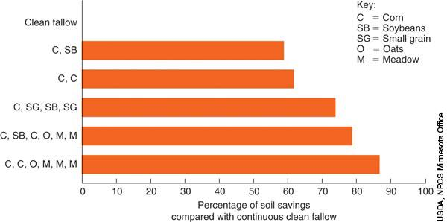
Figure 18-18, p. 424

Slide 49
Controlling Water Erosion
Water erosion can be minimized
Reduce raindrop impact and soil detachment
Reduce or slow runoff
Remove excess water safely
In grassed waterway, for example
Filter soil particles from running water

Slide 50
Practices to Control Water Erosion
Methods
Soil improvements (to increase infiltration, reduce runoff) – K factor
Vegetative cover – C factor
Conservation tillage – C factor
Contour practices – P factor
Contour tillage
Strip cropping
Grassed waterways – P factor

Slide 51
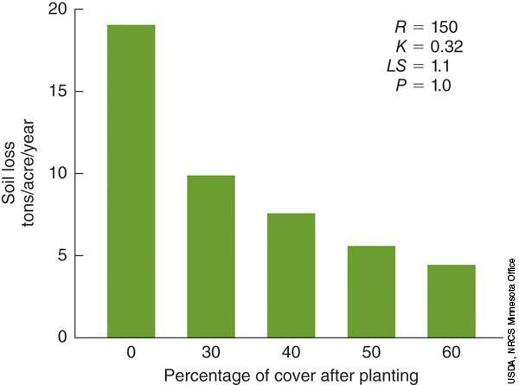
Figure 18-20, p. 425

Slide 52
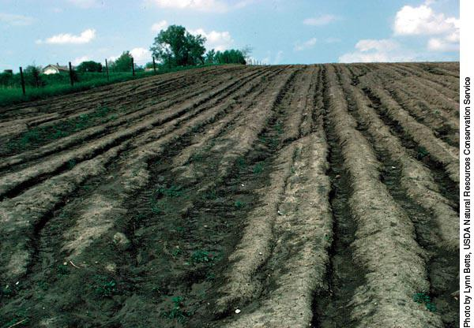
Figure 18-8, p. 414
Surface roughness in wrong direction

Slide 53
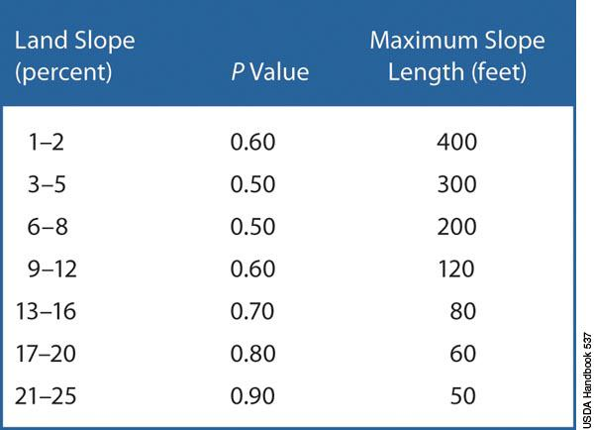
Figure 18-16, p. 421
P: Contour tillage “support practice”

Slide 54
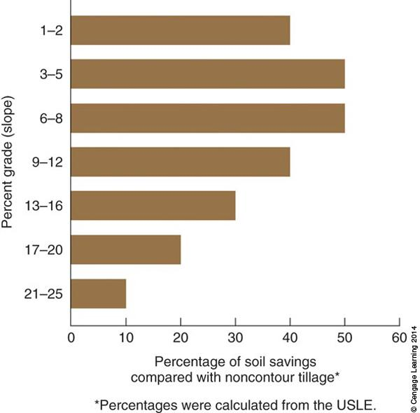
Figure 18-22, p. 427
Contour tillage
is effective
Strip-cropping
needed to
complement
contour tillage

Slide 55
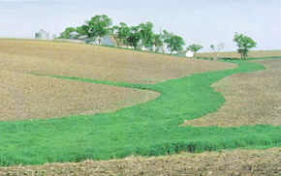
Grassed Waterways

Slide 56
Practices to Control Water Erosion (cont’d.)
Conservation buffers – P factor
Filter strips (edge of fields)
Riparian buffers – strips of permanent vegetation along streams, wetlands and other bodies of water to protect water quality from field runoff
Terraces – P factor

Slide 57
Predicting Soil Loss
Universal Soil Loss Equation
A = R K LS C P
A: Tons of soil lost per acre each year
R: Rainfall and runoff factor (changing?)
K: Soil erodibility factor
LS: Slope factor
C: Cover and management factor
P: Support practice factor
Revised: refined factor values (“RUSLE”)

Slide 58
USDA Erosion Designations
T, the “tolerable” soil loss tonnage per year
Not synonymous with “sustainable”
Based on depth to restrictive soil horizon
Restrictions include bedrock, fragipan, rocks
1 T/A/yr if restriction (e.g., bedrock) is <10” deep
5 T/A/yr if restriction is >60” deep
Mostly 4 or 5, some 3 & a 2 in Harford County
Remember, 1 mm/yr = ~6 T/A/yr sheet erosion

Slide 59
USDA Erosion Designations (cont’d)
Highly Erodible Land (HEL)
Part of Food Security Act of 1985
Defined as land where RKLS/T > 8
RKLS/T is called “erosion index”, EI
Land Capability Subclass (Classes II to IV, VI to VIII)
“e” used where slope >2%
Prime Farmland (related term, not just erosion)
Defined in glossary, protected sometimes

Slide 60
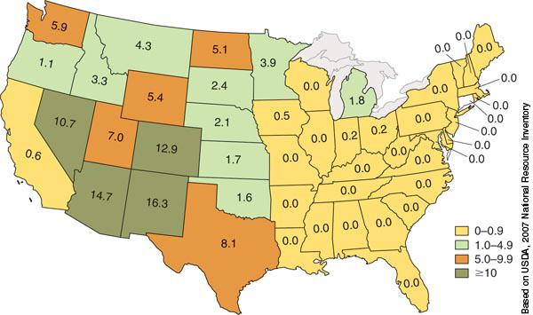
Figure 18-27, p. 431
Annual wind erosion (T/A/yr)

Slide 61
Wind Erosion
Causes
Larger soil particles extend past the boundary layer (“still air”) and are moved when wind reaches 10 to 13 mph
Saltation: movement by short bounces
Suspension: fine silt and clay particles rise as dust and are carried long distances
Surface creep: coarse sand particles react to saltating sand grains and roll along the ground

Slide 62
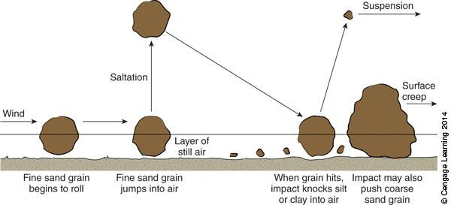
Figure 18-28, p. 432

Slide 63
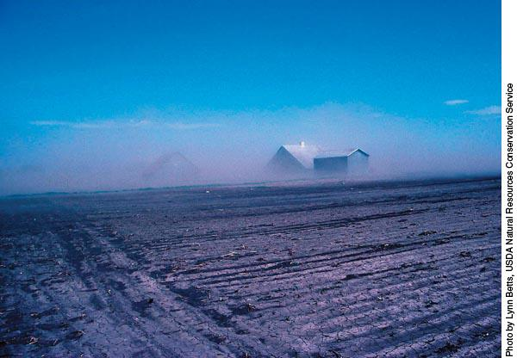
Figure 18-30, p. 433

Slide 64
Wind Erosion (cont’d.)
Effects
Removes soil and organic matter
Reduces nutrient-holding and water-holding capacities
Damages young plants
Factors
Texture, structure, and roughness
Climate, field length, and vegetative cover
Wind Erosion Equation
Soil-loss formula

Slide 65
Wind Erosion (cont’d.)
Preventing wind erosion
Till at right angles to the wind
Use conservation tillage or subsurface tillage tools
Use vegetative cover
Cover crops
Moisten soil with irrigation during windy conditions
Plant windbreaks
Plant critical areas to grasslands or vegetative cover

Slide 66
Wind Erosion (cont’d.)
Critical periods
When the soil is fallowed (left bare to conserve moisture by eliminating transpiration)
Between harvest and following crop cover

Slide 67
Erosion and Climate Change
Considerations
Current erosion technologies (outdated?)
Response to mid-twentieth century conditions
Highly erosive rainfall
Likely to increase
RUSLE
May become unreliable
Wind and dryness
May increase
Agricultural practices
Adjustments to will be needed

Slide 68
Summary
This chapter reviewed several topics
Water and wind erosion
Water causes about three-fifths of total erosion losses
Soil loss computing
USLE (or RUSLE)
Erosion control practices
Contour tillage, contour strip cropping, etc.
Climate change
Will likely challenge efforts to predict and control erosion

Slide 69
Chapter 20
Government Agencies and Programs

Slide 70
Objectives
After completing this chapter, you should be able to:
List federal agencies that assist soil users
Describe some of the soil programs of these agencies

Slide 71
Government Agencies and Programs
A network of agencies and regulations help growers in several ways
Education
Technical assistance
Financial assistance
Research

Slide 72
USDA Agencies
Cooperative State Research, Education, and Extension Service (CSREES) – 19th Century
Merges extension/research activities in programs at state Agriculture Experiment Stations
Experiment Stations, and the CSREES programs housed in them, are located at land-grant universities and are jointly funded by state and federal dollars

Slide 73
USDA Agencies (cont’d.)
Farm Service Agency (FSA) – 20th Century
Administers and funds agricultural programs including some soil conservation programs
Uses Natural Resources Conservation Service technical expertise

Slide 74
USDA Agencies (cont’d.)
Natural Resources Conservation Service (NRCS)
Replaced Soil Conservation Service
Provides varied assistance & funding

Slide 75
USDA Agencies (cont’d.)
Soil (and Water) Conservation Districts (SWCD or, in MD, SCD)
Many USDA programs operate through SWCDs
Not federal agencies
Have formal agreements with the U.S. Secretary of Agriculture

Slide 76
USDA Conservation Programs
National Resources Conservation Service and the Farm Service Agency
Operate several programs aiming to conserve the nation’s soil and water resources
Programs are authorized by periodic “Farm Bills” of Congress

Slide 77
USDA Conservation Programs (cont’d.)
Conservation Reserve Program (CRP)
First authorized by 1985 farm bill
Purchases 10- to 15-year easements from growers
In exchange, growers plant permanent cover, such as native grasses or trees
Administered by the FSA and NRCS
Enhances wildlife instead of crop production

Slide 78
USDA Conservation Programs (cont’d.)
Wetland Reserve Program (WRP)
Functions like the CRP, but is designed to protect or restore wetlands
Conservation Compliance Programs
Require growers to take certain conservation measures to remain eligible for federal price-support programs
Penalties instead of incentives

