Slide 1
Students will be able to create an
Annotated Bibliography by finding
reliable, credible web and
database sources.

Slide 2
Let’s Review…..
You’ve seen it all before, so this is just
to refresh your memory.
1. Summarizing/Paraphrasing
2.Using Data bases – SIRS, GALE and Facts on File
3.Evaluating Web sources using CRAB
4.Using Noodle Tools to manage sources to create an Annotated Bibliography

Slide 3
Remember the 2/3, 1/3 Rule
Two-thirds of your writing should
be either paraphrasing, or your
thoughts, ideas or opinions.
Only one-third of your writing
should be direct quotes from
a source.
Paraphrasing from another’s work can be challenging,
but it is a skill that is very important to become good at!

Slide 4
Practice makes perfect…
At the party we had delicious red punch, a bunch
of different appetizers, and a cookout.
Since it was at the park, we played volleyball,
went swimming, and sunbathed for fun.
The main point of this passage is that
At the party we enjoyed food and drink and various outdoor activities

Slide 5
Try again…
Enforcing time limits is important because welfare is intended to be used for only a short while by people who are temporarily out of work it is not intended to be a way of life.
What is the main idea of the author….in 3 words!

Slide 6
Now on to the sources….

Slide 7
Using a database instead of a web source
solves a couple of problems,
first, you don’t have to evaluate the sources,
secondly you get citations done for you, and
thirdly, you’ll be expected to know
how to use them in college.

Slide 8
C
R A B

Slide 9
E
V
A
L
U
A
T
E
Y
O
U
R
W
E
B
S
I
T
E
Web Evaluation
C Currency
RRelevance
When was the page written or updated?
Is the information current/up-to-date enough for your topic?
Why was the page put on the web?
Does this answer my research question?
What is the domain extension?
A Accuracy
BBias
Based on the writing style and vocabulary, who is the intended audience?
Is the content primarily opinion?
Is it reliable information?
Who wrote the page?
Is there evidence that the author or organization is an expert on this subject?

Slide 11
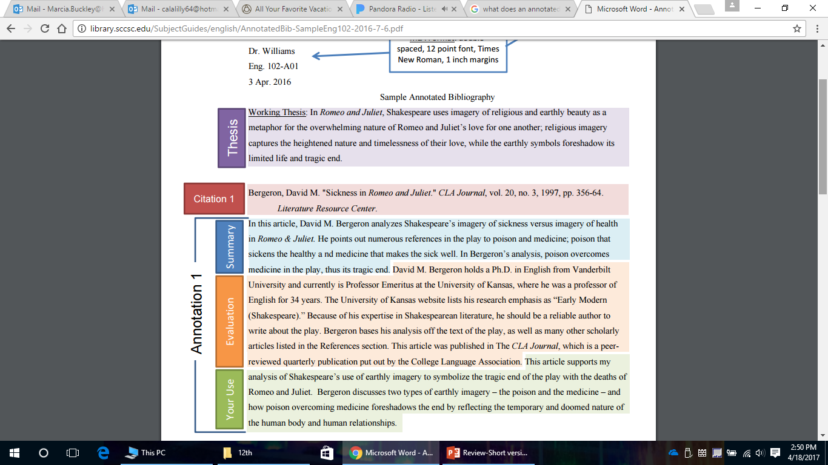

Slide 12
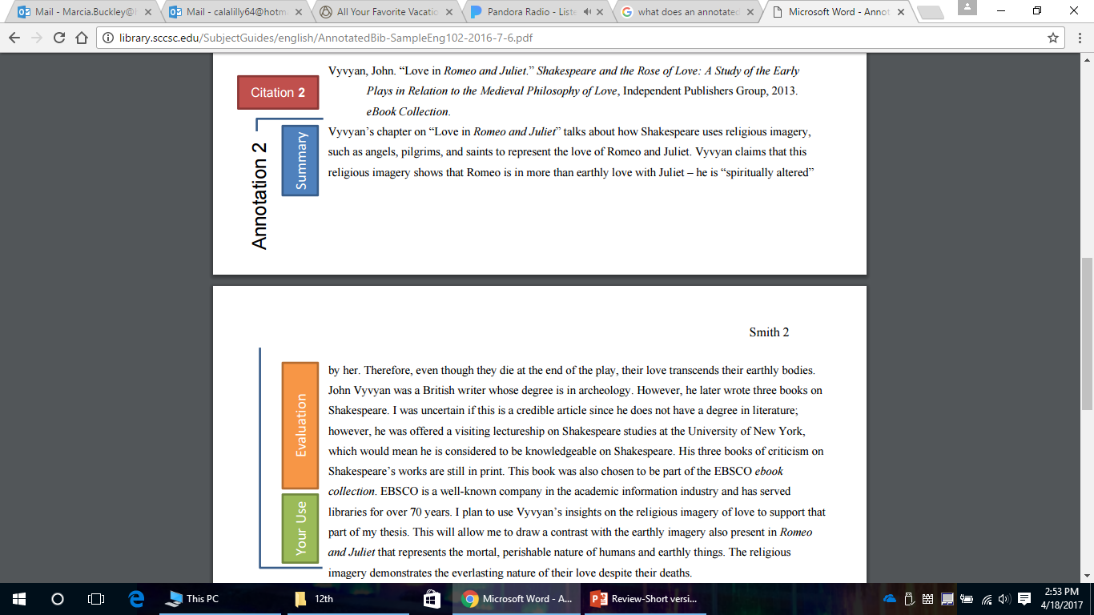

Slide 13
Whether you are using a web source,
data base or a BOOK you will need to
create an NoodleTools project for this
assignment.
You will be able to annotate and export
your Bibliography from NoodleTools.

