Slide 1
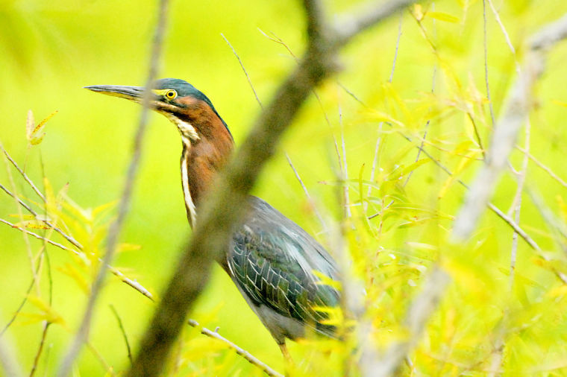
ENVIROTHON Wildlife ID C. Milton Wright HS
Andy Adams
Susquehannock Wildlife Society
Loyola University MD

Slide 2
Wildlife Identification
Ultimately comes with experience
It’s really hard to keep a constant running catalogue of each and every species
Use shortcuts where possible – narrow down certain characteristics to perhaps the family group
Start to pick out and focus on specific traits that sets that critter apart from others
Begin to recognize the “GISS” of that species (general impression of size and shape)
Let your field guides do the rest
Studystudystudy

Slide 3
Wildlife Identification
Amphibians
Frogs
Salamanders
Reptiles
Turtles
Lizards
Snakes
Birds
Shorebirds and wading birds
Ducks and geese
Raptors
Songbirds
Woodpeckers
Sparrows, finches, etc.
Mammals
Marsupials
Insectivores
Bats
Lagomorphs
Rodents
Hooved mammals (artiodactylids)
Carnivores
Canines
Felines
Weasels (mustelids)
Others

Slide 4
Amphibians - Frogs
Ranidae (true frogs)
American bullfrog
Northern green frog
Wood frog
Pickerel frog
Southern leopard frog
Bufonidae (true toads)
American toad
Fowler’s toad
Hylidae (treefrogs)
Green treefrog
Gray treefrog
Spring peeper
Northern cricket frog
Pelobatidae (spadefoot)
Eastern spadefoot toad
Microhylidae (narrow-mouth)
Eastern narrow mouth toad

Slide 5
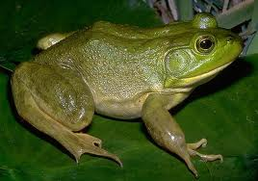
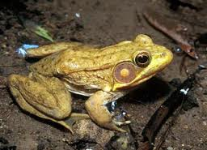
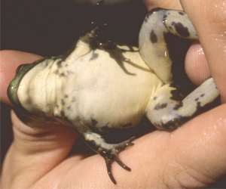
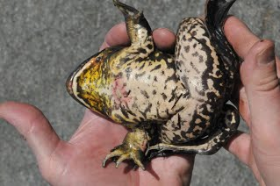
American Bullfrog
(Lithobates catebeianus)
Northern green frog
(Lithobates clamitans)

Slide 6
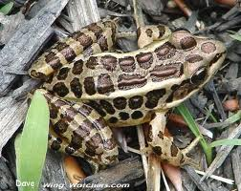
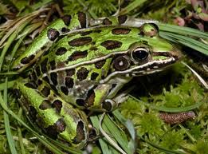
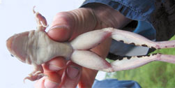
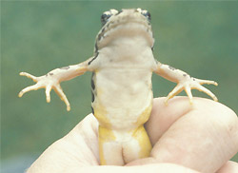
Pickerel Frog
(Lithobates palustris)
Southern leopard frog
(Lithobates sphenocephalus)

Slide 7
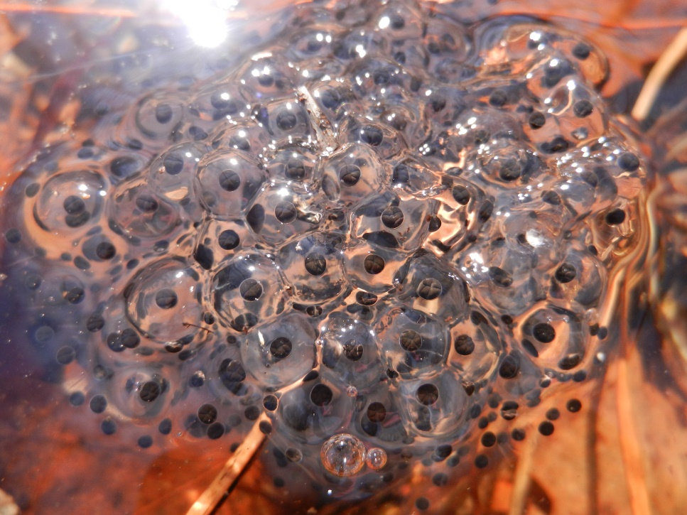
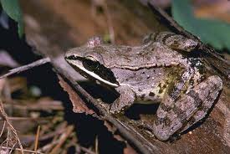
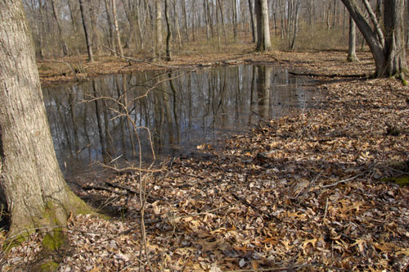
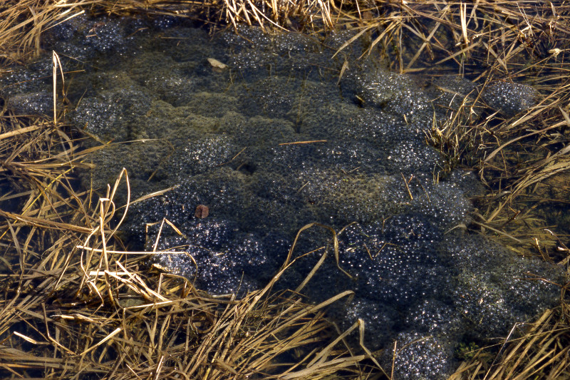
Wood frog
(Lithobates sylvaticus)

Slide 8
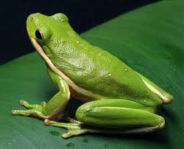
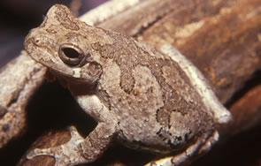
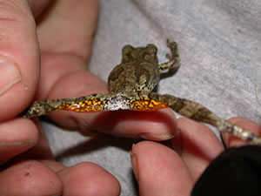
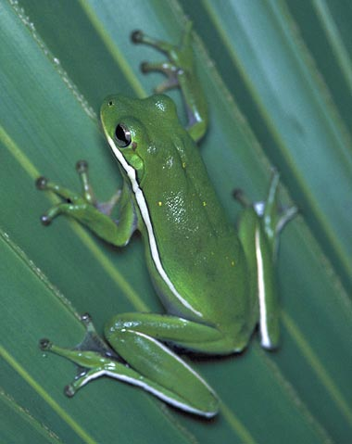
Green treefrog
(Hyla cinereus)
Gray treefrog
(Hyla versicolor)

Slide 9
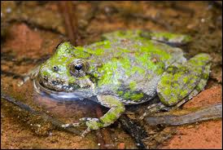
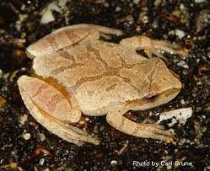
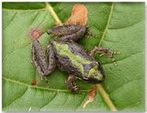
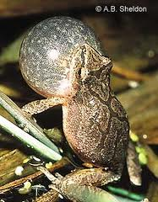
Northern cricket frog
(Acris crepitans)
Spring peeper
(Pseudacris crucifer)

Slide 10
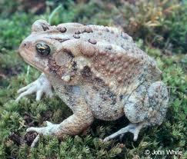
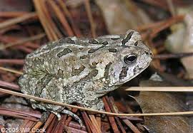
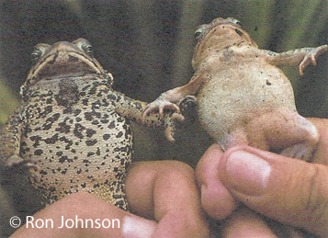
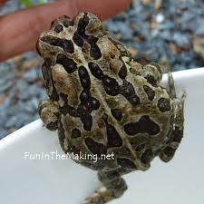
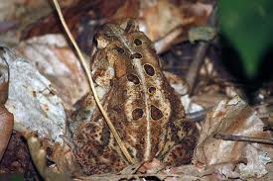
American toad
(Anaxyrus americanus)
Fowler’s toad
(Anaxyrus fowleri)

Slide 11
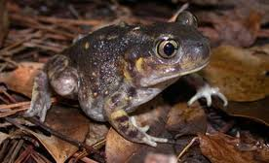
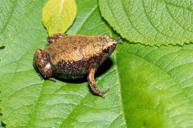
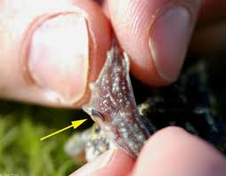
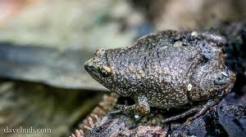
Eastern spadefoot toad
(Scaphiopus holbrookii)
Eastern narrow mouth toad
(Gastrophryne carolinensis)

Slide 12
Amphibians - Salamanders
Plethodontidae (lungless salamanders)
Eastern redback salamander
Northern slimy salamander
Northern dusky salamander
Northern two-lined salamander
Long-tailed salamander
Northern red salamander
Four-toed salamander
Ambystomatidae (mole salamanders)
Spotted salamander
Marbled salamander
Salamandridae (newts)
Eastern red-spotted newt

Slide 13
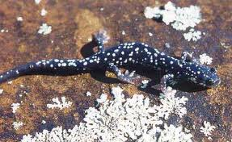
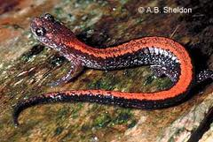
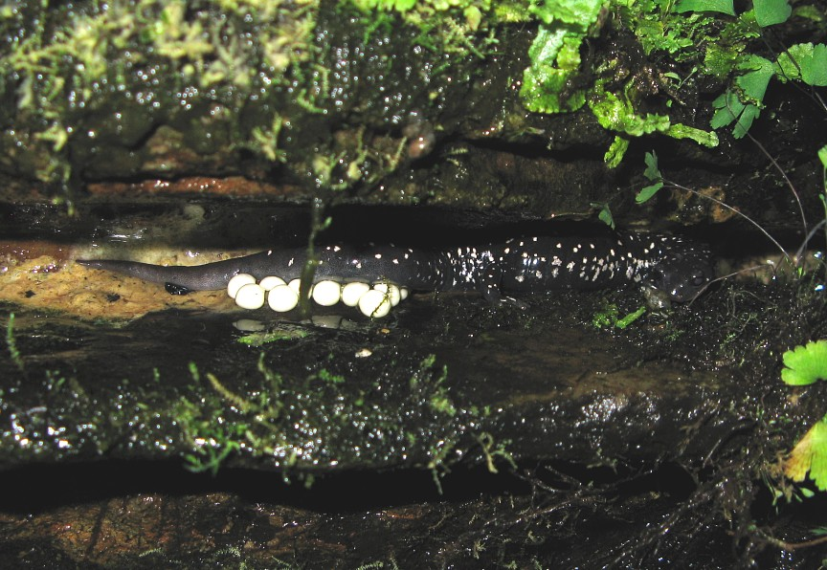
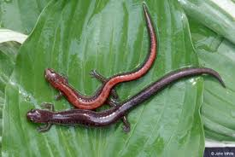
Eastern redback salamander
(Plethodon cinereus)
Northern slimy salamander
(Plethodon glutinosus)

Slide 14
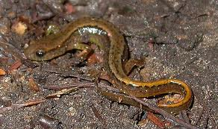
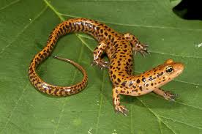
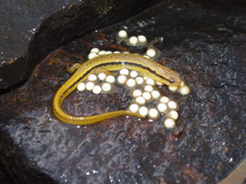
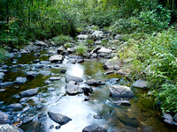
Northern two-lined salamander
(Eurycea bislineata)
Long-tailed salamander
(Eurycea longicauda)

Slide 15
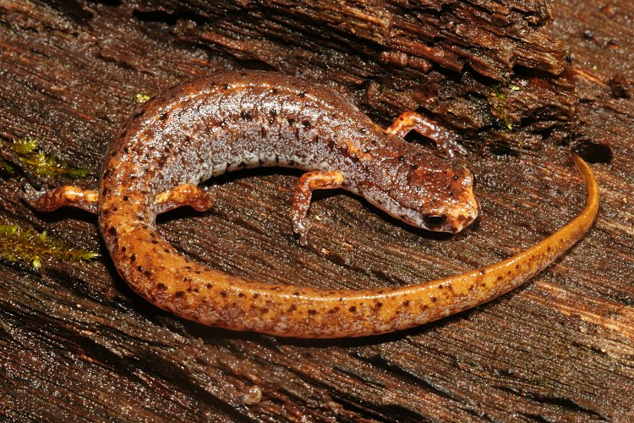
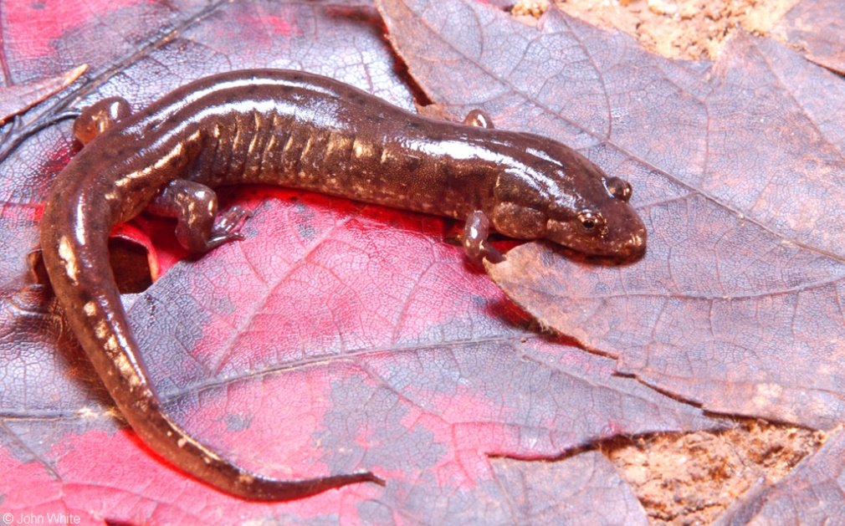
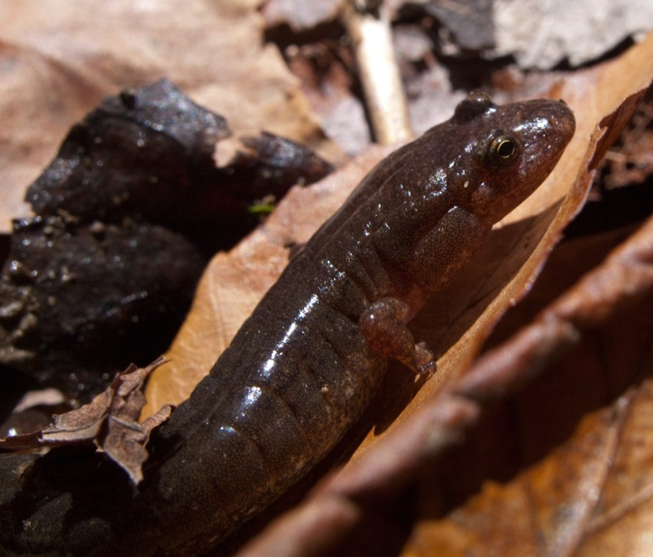
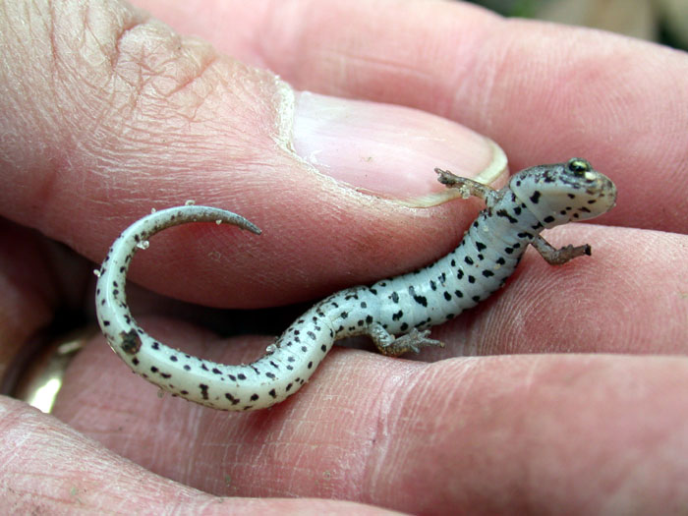
Four-toed salamander
(Hemidactylum scutatum)
Northern dusky salamander
(Desmognathus fuscus)

Slide 16
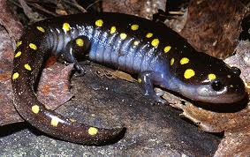
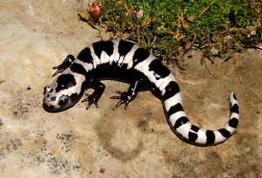
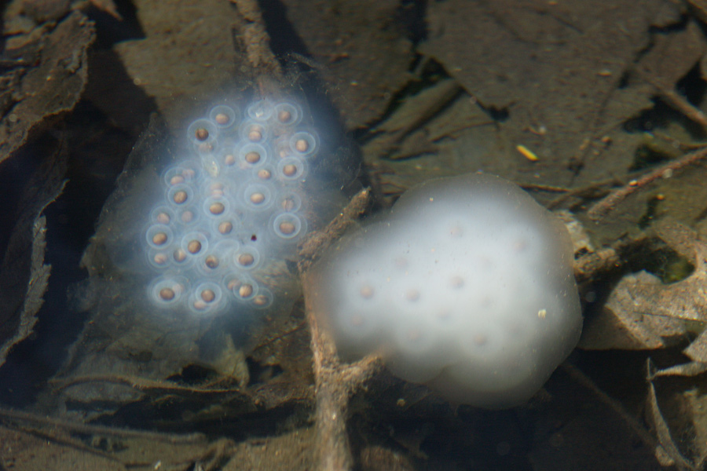
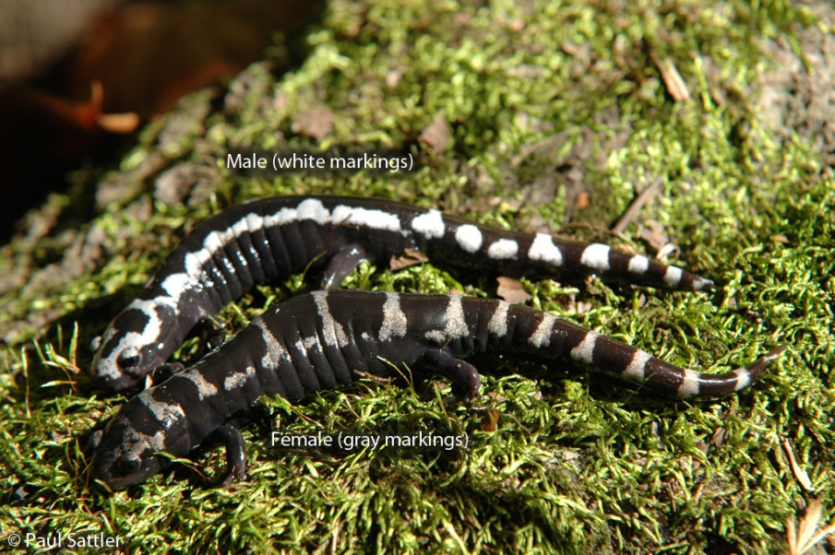
Spotted salamander
(Ambystoma maculatum)
Marbled salamander
(Ambystoma opacum)

Slide 17
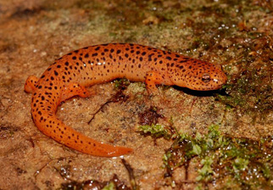
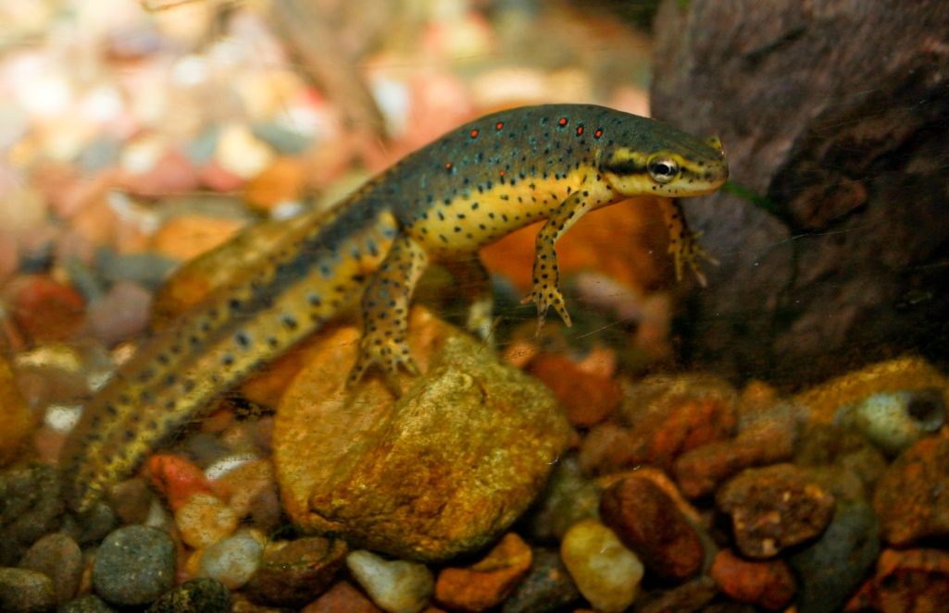
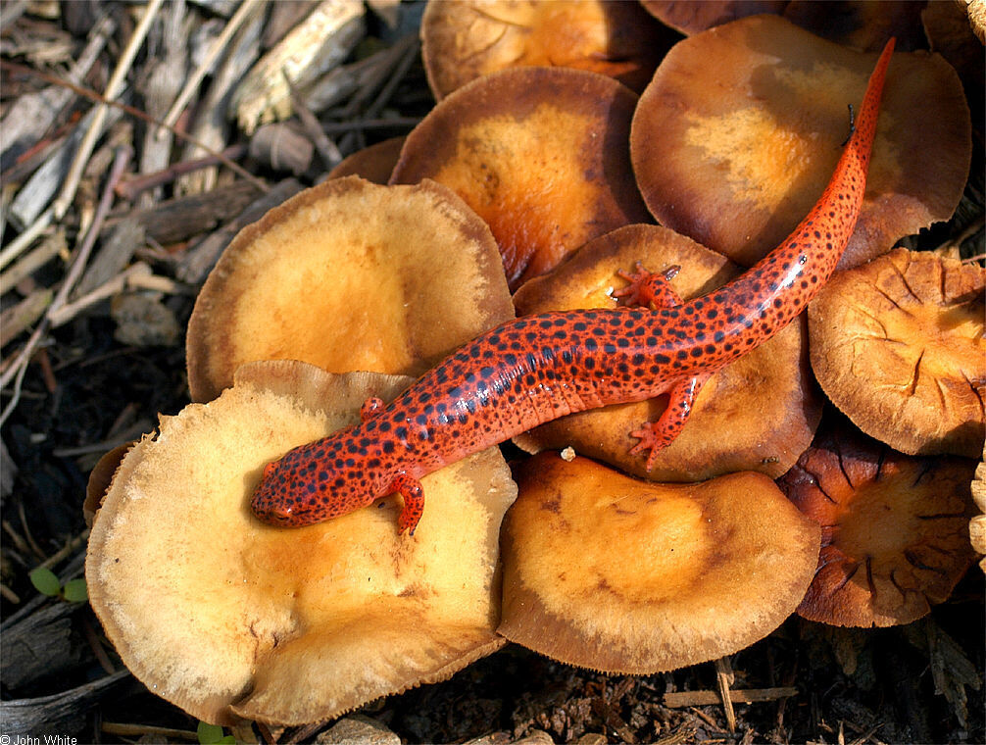
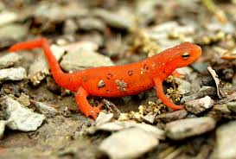
Northern red salamander
(Eurycea bislineata)
Eastern red-spotted newt
(Notopthalamus viridescens)

Slide 18
Reptiles - Turtles
Chelydridae
Snapping turtle
Kinosternidae
Eastern mud turtle
Eastern musk turtle
Emydidae
Red-eared slider
Eastern painted turtle
Northern redbelly turtle
Spotted turtle
Wood turtle
Eastern box turtle
Northern diamondback terrapin

Slide 19
Eastern mud turtle
(Kinosternon subrubrum)
Eastern musk turtle
(Sternotherus odoratus)

Slide 20
Snapping turtle
(Chelydra serpentina)
Eastern painted turtle
(Chrysemys picta)

Slide 21
Red-eared slider
(Trachemys scripta elegans)
Northern red-bellied cooter
(Pseudemys rubriventris)

Slide 22
Spotted turtle
(Clemmys guttata)
Wood turtle
(Glyptemys insculpta)

Slide 23
Eastern box turtle
(Terrapene carolina)
Northern diamondback terrapin
(Malaclemys terrapin)

Slide 24
Reptiles - Lizards
Scincidae (skinks)
Five-lined skink
Broadhead skink
Phrynosomatidae (spiny lizards)
Eastern fence lizard
Teiidae (whip-tails)
Six-lined racerunner

Slide 25
Five-lined skink
(Plestiodon fasciatus)
Broadhead skink
(Plestiodon laticeps)

Slide 27
Six-lined racerunner
(Aspidoscelis sexlineatus)
Eastern fence lizard
(Sceloporus undulatus)

Slide 28
Snake Families of MD
Colubridae
Northern water snake
Eastern garter snake
Eastern ribbon snake
Queen snake
Eastern milk snake
Eastern kingsnake
Eastern hognose snake
Eastern rat snake
Northern black racer
Rough green snake
Northern ringneck snake
Northern brown snake
Redbellied snake
Eastern worm snake
Crotalidae
Northern copperhead
Timber rattlesnake

Slide 29
Eastern garter snake
(Thamnophis sirtalis)
Eastern ribbon snake
(Thamnophis sauritis)

Slide 30
Northern water snake
(Nerodia sipedon)
Queen snake
(Regina septemvittata)

Slide 31
Eastern milk snake
(Lampropeltis triangulum)
Eastern kingsnake
(Lampropeltis getula)

Slide 32
Eastern rat snake
(Pantherophis allegheniensis)
Northern black racer
(Coluber constrictor)

Slide 33
Eastern hognose snake
(Heterodon platirhinos)
Eastern worm snake
(Carphophus amoenus)

Slide 34
Rough green snake
(Opheodrys aestivus)
Northern ringneck snake
(Diadophis punctatus edwardsii)

Slide 35
Northern brown snake
(Storeria dekayi)
Redbellied snake
(Storeria occipitomaculata)

Slide 36
Northern copperhead
(Agkistrodon contortrix mokasen)
Timber rattlesnake
(Crotalus horridus)

Slide 37
Birds – Shorebirds and Wading Birds
catch fish and other aquatic critters
Adapted for life around the water
Some have long legs, sinewy necks, and spear-like beaks for fishing
Others fish during flight and have large beak to grab fish

Slide 38
Birds – Shorebirds and Wading Birds
Double-crested cormorant
Great blue heron
Great egret
Snowy egret
Green heron
Black-crowned night heron

Slide 39
Double-crested cormorant
Great blue heron

Slide 40
Great egret
Snowy egret

Slide 41
Black-crowned night heron
Green heron

Slide 42
Birds – Ducks and Geese
Mostly aquatic – any habitat with water
Most have generally flattened beak (bill)
Webbed feet for swimming
A few eat fish, but most are adapted for eating aquatic vegetation and invertebrates
Can occur in large groups – will also travel together

Slide 43
Birds – Ducks and Geese
Mute swan
Tundra swan
Canada goose
Wood duck
Mallard
American black duck
Green-winged teal
Northern pintail
Northern shoveler
Canvasback
Bufflehead
Ruddy duck
Mergansers

Slide 44
Tundra swan
Mute swan

Slide 45
Canada goose
Wood duck
https://www.youtube.com/watch?v=JkBSkFyUyv0

Slide 46
Mallard
American black duck

Slide 47
Green-winged teal
Northern pintail

Slide 48
Northern shoveler
Canvasback

Slide 49
Bufflehead
Ruddy duck

Slide 50
Red-breasted merganser
Hooded merganser

Slide 51
Birds - Raptors
Birds of prey or “raptors” – means “to seize or steal”
Strong hooked beak for tearing meat
Large powerful talons for grabbing prey
Superb eyesight
Tend to soar high in the air searching for prey, then dive at high speeds to apprehend it

Slide 52
Birds - Raptors
Bald eagle
Osprey
Red-tailed hawk
Red-shouldered hawk
Peregrine falcon
American kestrel
Great-horned owl
Eastern screech owl
Barred owl
Barn owl
Turkey vulture
Black vulture

Slide 53
Turkey vulture
Black vulture

Slide 54
Osprey
Bald eagle

Slide 55
Red-shouldered hawk
Red-tailed hawk

Slide 56
American kestrel
Peregrine falcon
https://www.youtube.com/watch?v=legzXQlFNjs

Slide 57
Great-horned owl
Eastern screech owl

Slide 58
Barred owl
Barn owl

Slide 59
Birds – Songbirds - Woodpeckers
Insectivores
Modified beak and skull
for hammering wood
Spiky tongue for inserting into trees and spearing insects
Zygodactyl feet to grasp vertical surfaces

Slide 60
Birds – Songbirds - Woodpeckers
Downy woodpecker
Hairy woodpecker
Red-bellied woodpecker
Northern flicker
Pileated woodpecker

Slide 61
Downy woodpecker
Hairy woodpecker

Slide 62
Red-bellied woodpecker
Northern flicker

Slide 63
Pileated woodpecker

Slide 64
Birds – Songbirds
“Perching birds”
The largest and most diverse group of birds by far – more than half or all bird species in the world
Usually small
Wide range of complicated vocalizations
Lay colored eggs
Wide variety of diets and habitats

Slide 65
Birds – Songbirds
American crow
Common raven
Blue jay
Tufted titmouse
Carolina chickadee
Carolina wren
White-breasted nuthatch
Wood thrush
American robin
Eastern bluebird
Gray catbird
Northern mockingbird
Red-winged blackbird
European starling
Cedar waxwing
Northern cardinal
Scarlet tanager
Eastern towhee
Dark-eyed junco
White-throated sparrow
House sparrow
Brown-headed cowbird
Common grackle
Baltimore oriole
Rose-breasted grosbeak
Purple finch
House finch
American goldfinch

Slide 66
American crow
Common raven
Blue Jay

Slide 67
Tufted titmouse
Carolina chickadee

Slide 68
Carolina wren
White-breasted nuthatch

Slide 69
Wood thrush
American robin

Slide 70
Eastern bluebird
Gray catbird

Slide 71
Northern mockingbird
Red-winged blackbird

Slide 72
European starling
Cedar waxwing

Slide 73
Scarlet tanager
Northern cardinal

Slide 74
Eastern towhee
Dark-eyed junco

Slide 75
White-throated sparrow
House sparrow

Slide 76
Brown-headed cowbird
Common grackle

Slide 77
Baltimore oriole
Rose-breasted Grosbeak

Slide 78
Purple finch
House finch
American goldfinch

Slide 79
Birds – Random Oddballs
Rove dove
Mourning dove
Ruby-throated hummingbird
Kingfisher
American woodcock
Whip-poor-will
Wild turkey

Slide 80
Rock dove
Mourning dove

Slide 81
Whip-poor-will
Wild turkey

Slide 82
https://www.youtube.com/watch?v=TFnKFF8eYfs&feature=related
American woodcock

Slide 83
Belted kingfisher
Ruby throated hummingbird

Slide 84
Mammals - Marsupials
Primitive group
Characterized by raising their embryonic young in a pouch
Only one in the US
Virginia opossum
(Didelphis virginiana)

Slide 85
Mammals - Insectivores
Shrews, moles, etc.
Among the smallest mammals in North America
Eat mostly insects and other invertebrates
Similar-looking to rodents, but actually quite different
Lack large incisors, instead have long row of sharp teeth
Longer nose and skull
Five toes on front feet (rodents have 4)
Rodents tend to be herbivorous/omnivorous, insectivores are carnivorous
Rodents have large eyes; insectivores have very tiny/reduced eyes and get around mostly by touch and sound

Slide 86
Mammals - Insectivores
Shrews
Moles

Slide 87
Mammals - Bats

Slide 88
Mammals - Lagomorphs
Eastern cottontail

Slide 89
Mammals - Rodents
Eastern chipmunk
Eastern gray squirrel
Eastern fox squirrel
Southern flying squirrel
Groundhog/woodchuck
Muskrat
American beaver
Nutria
Mice, rats, and voles

Slide 90
Eastern gray squirrel
(Sciurus carolinensis)
Eastern fox squirrel
(Sciurus niger)

Slide 91
Eastern chipmunk
(Tamias striatus)
Southern flying squirrel
(Glaucomys volans)

Slide 92
Common muskrat
(Ondatra zibethicus)
American beaver
(Castor canadensis)

Slide 93
Woodchuck
(Marmota monax)
Nutria
(Myocastor coypus)

Slide 94
Mammals - Mice, Rats, and Voles
Mouse
Rat
Vole

Slide 95
Mammals – Hooved Mammals (Artiodactylids)
White-tailed deer

Slide 96
Mammals - felines
Bobcat

Slide 97
Mammals - Canines
Coyote
Red fox
Gray fox

Slide 98
Mammals – Carnivores – Weasels (mustelids)
Least weasel
Long-tailed weasel
Striped skunk

Slide 99
Mammals – Carnivores – Weasels (mustelids)
Mink
River otter

Slide 100
Mammals – Carnivores - others
Raccoon
Black bear

